Slide 1
IBM COURSERA CAPSTONE
By
Arohi Narang

Slide 2
Introduction
Malls are a great source of entertainment especially during weekends and holidays.
People can do grocery shopping, dine at restaurants, shop at the various fashion outlets, watch movies and perform many more recreational activities. It is a place enjoyed by all age groups and no one can ever get bored at a mall.
Malls are the paradise for all types of shoppers. For retailers, the central location and the large crowd at the shopping malls provides a great distribution channel to market their products and services. Builders also try to buy land close to shopping malls.
As a result, there are many shopping malls in the city of Mumbai and many more are being built.
Opening shopping malls allows property developers to earn consistent rental income. Of course, as with any business decision, opening a new shopping mall requires serious consideration and is a lot more complicated than it seems. Particularly, the location of the shopping mall is one of the most important decisions that will determine whether the mall will be a success or a failure.

Slide 3
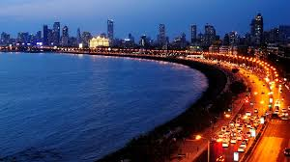
Business Problem
The objective of this capstone project is to analyse and select the best locations in the city of Mumbai, Maharashtra to open a new shopping mall. Using data science and machine learning techniques like clustering, this project aims to provide solutions to answer the business question: Which are the best locations in Mumbai where a property developer should look to open a new shopping mall?
Target Audience of this project
This project is particularly useful to property developers and investors looking to open or invest in new shopping malls in the city of Mumbai

Slide 4
Methodology
Data Extraction: We get the list of neighbourhoods in the city of Mumbai from the Wikipedia page (https://en.wikipedia.org/wiki/Category:Suburbs_in_Mumbai). We will do web scraping using Python requests and beautiful soup packages to extract the list of neighbourhoods data.
Obtain Geographical Coordinates: We get the geographical coordinates in the form of latitude and longitude by using the wonderful Geocoder package. It converts the address into geographical coordinates in the form of latitude and longitude.
Visualization on Map: After gathering the data, we will populate the data into a pandas Data Frame and then visualize the neighbourhoods in a map using Folium package. This allows us to perform a sanity check to make sure that the geographical coordinates data returned by Geocoder are correctly plotted in the city of Mumbai.

Slide 5
Methodology Cotinued
Use Of Foursquare API: We use this tool to get the top 100 venues that are within a radius of 2000 meters. We need to register a Foursquare Developer Account in order to obtain the Foursquare ID and Foursquare secret key. We then make API calls to Foursquare passing in the geographical coordinates of the neighbourhoods in a Python loop. Foursquare will return the venue data in JSON format and we will extract the venue name, venue category, venue latitude and longitude. With the data, we can check how many venues were returned for each neighbourhood and examine how many unique categories can be curated from all the returned venues. Then, we will analyse each neighbourhood by grouping the rows by neighbourhood and taking the mean of the frequency of occurrence of each venue category. By doing so, we are also preparing the data for use in clustering. Since we are analysing the “Shopping Mall” data, we will filter the “Shopping Mall” as venue category for the neighbourhoods

Slide 6
Methodology Cotinued
K means Clustering: Lastly we perform clustering on the data by using k-means clustering. K-means clustering algorithm identifies k number of centroids, and then allocates every data point to the nearest cluster, while keeping the centroids as small as possible. It is one of the simplest and popular unsupervised machine learning algorithms and is particularly suited to solve the problem for this project. We will cluster the neighbourhoods into 3 clusters based on their frequency of occurrence for “Shopping Mall”. The results will allow us to identify which neighbourhoods have higher concentration of shopping malls while which neighbourhoods have fewer number of shopping malls. Based on the occurrence of shopping malls in different neighbourhoods, it will help us to answer the question as to which neighbourhoods are most suitable to open new shopping malls

Slide 7
Results
The results from the k-means clustering show that we can categorize the neighbourhoods into 3 clusters based on the frequency of occurrence for “Shopping Mall”:
Cluster 0: Neighbourhoods with least number of shopping malls
Cluster 1: Neighbourhoods with moderate number of shopping malls
Cluster 2: Neighbourhoods with highest concentration of shopping malls
The results of the clustering are visualized in the map below with cluster 0 in red colour, cluster 1 in purple colour, and cluster 2 in mint green colour.

Slide 8
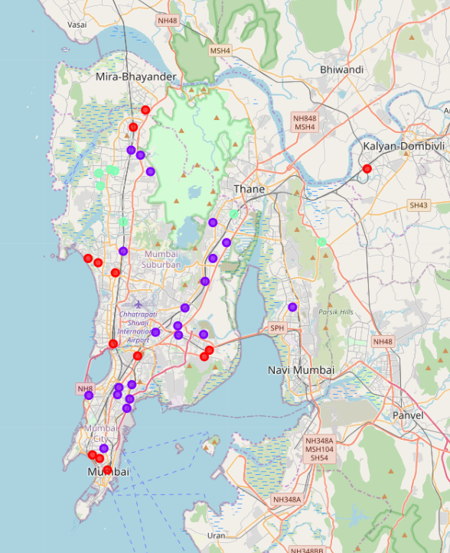
Cluster Groups

Slide 9
Limitations And Future Scope
In this project, we only consider one factor i.e. frequency of occurrence of shopping malls, there are other factors such as population and income of residents that could influence the location decision of a new shopping mall.
Future research could devise a methodology to estimate such data to be used in the clustering algorithm to determine the preferred locations to open a new shopping mall.
This project made use of the free account of Foursquare API that came with limitations as to the number of API calls and results returned. Future research could make use of paid account to bypass these limitations and obtain more results.
We have estimated the radius to get the information on the different venue categories. Each suburb in Mumbai has a different size. In the above project the radius of 5000 and if we take a higher radius it will be too big for the other suburbs. Thus Andheri bandra fall in cluster 0 but in reality there are malls in that suburb. They belong to the western suburb which is in cluster 2 and maybe if we increase the radius we will get a more accurate result.

Slide 10
Conclusion
This project recommends property developers to open new shopping malls in neighbourhoods in cluster 0 with little to no competition. Property developers with unique selling propositions to stand out from the competition can also open new shopping malls in neighbourhoods in cluster 1 with moderate competition. Lastly, property developers are advised to avoid neighbourhoods in cluster 2 which already have high concentration of shopping malls and suffering from intense competition especially the Western suburbs with the highest frequency of malls.

Slide 11
References
Category: Suburbs in Kuala Lumpur. Wikipedia. Retrieved from https://en.wikipedia.org/wiki/Category:Suburbs_in_Mumbai
Foursquare Developers Documentation. Foursquare. Retrieved from https://developer.foursquare.com/docs

